Slide 1
Internship Program: Soul Tech Vibe "Customer Order Analysis Using SQL"
Batch Name: SVT/DAINT/2025/06-B10

Slide 2
Introduction
In this task, I was asked to analyze higher education course data using SQL.
The main objective was to derive meaningful insights by writing SQL queries to filter, group, and summarize the information.
Through this analysis, I aimed to:
Understand the distribution of professional courses across districts.
Explore trends in course durations, college types, and universities.
Identify key patterns that support decision-making and improve operational understanding.
SQL was used as the primary tool to answer specific business questions, uncover trends, and provide clear, data-driven insights.

Slide 3
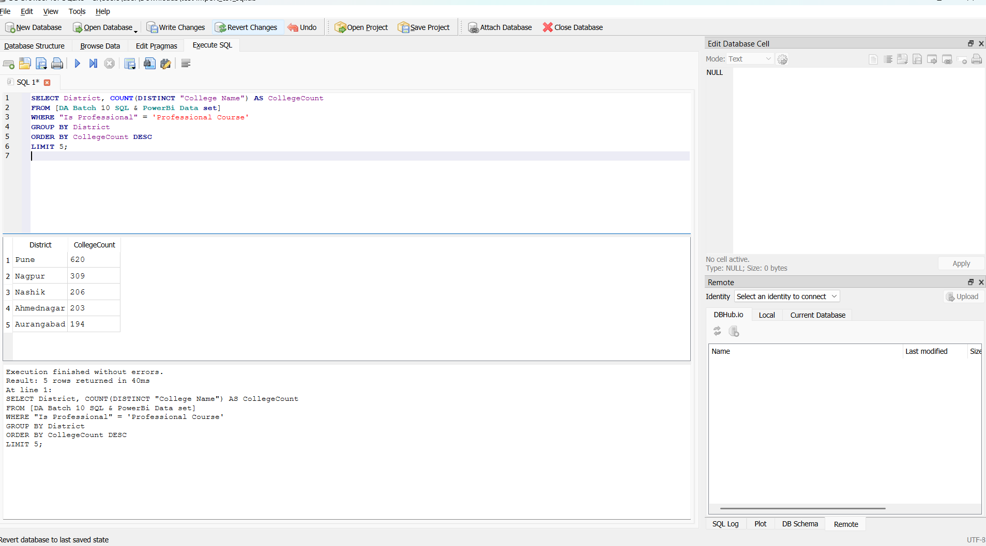
Q1 .top 5 districts with the highest number of colleges offering professional courses.

Slide 4
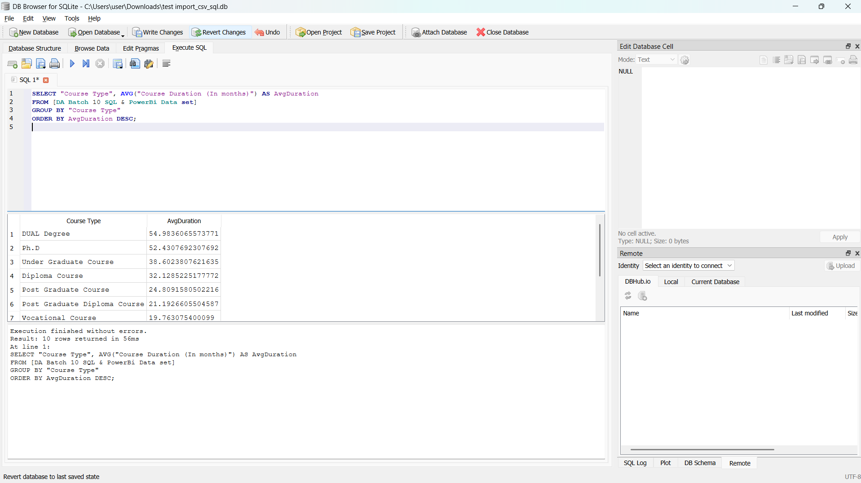
Q2.the average course duration (in months) for each Course Type and sort them in descending order.

Slide 5
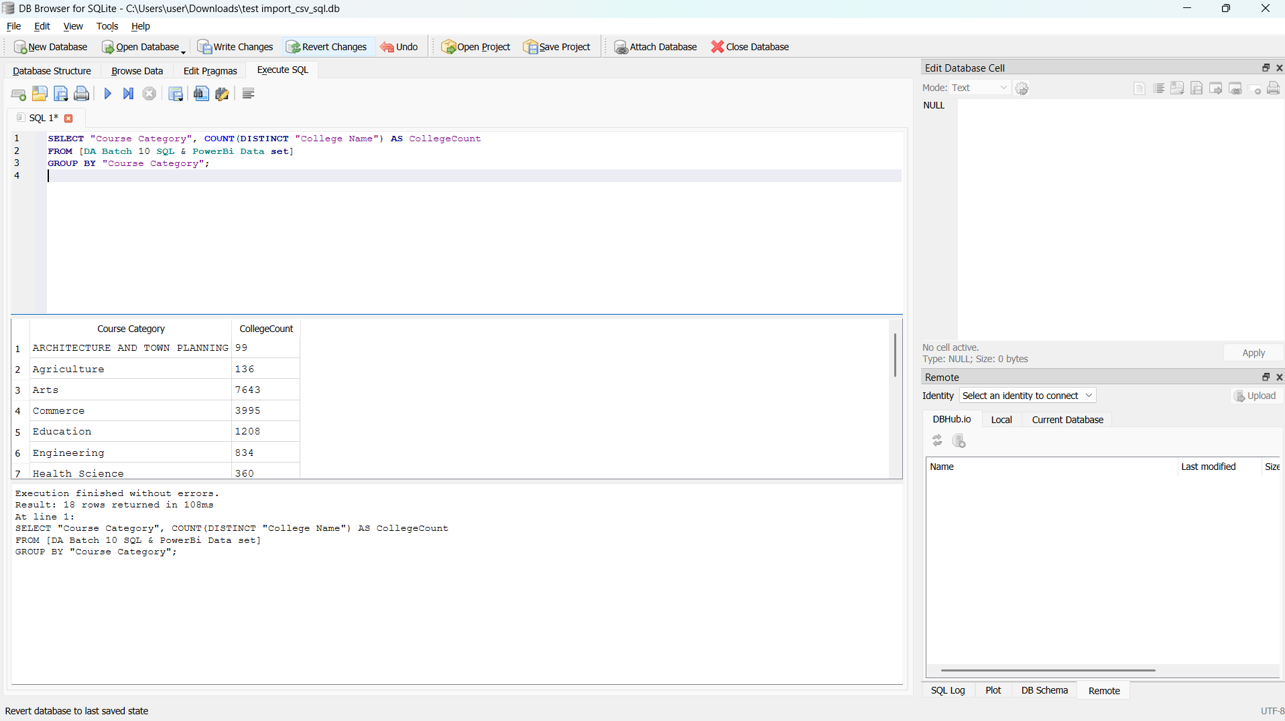
Q3 .Count how many unique College Names offer each Course Category.

Slide 6
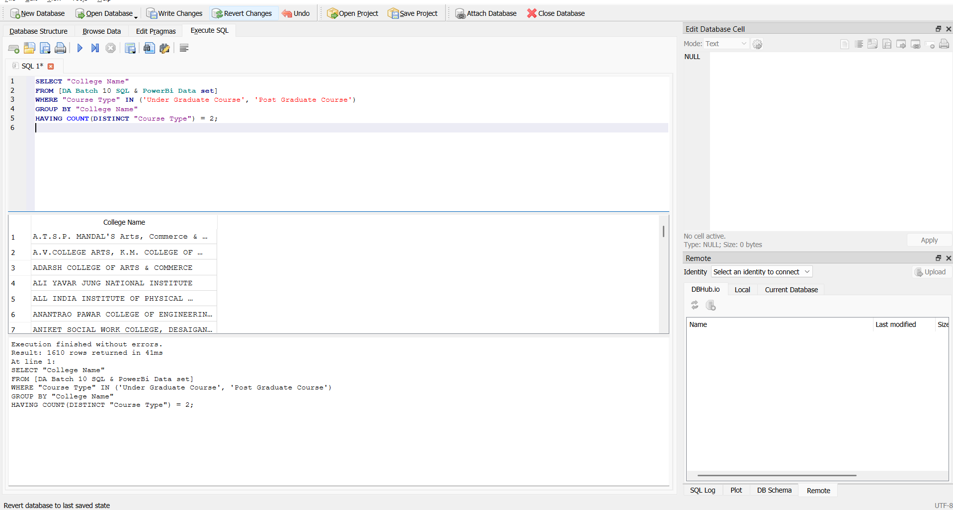
Q4. Find the names of colleges offering both Post Graduate and Under Graduate courses.

Slide 7
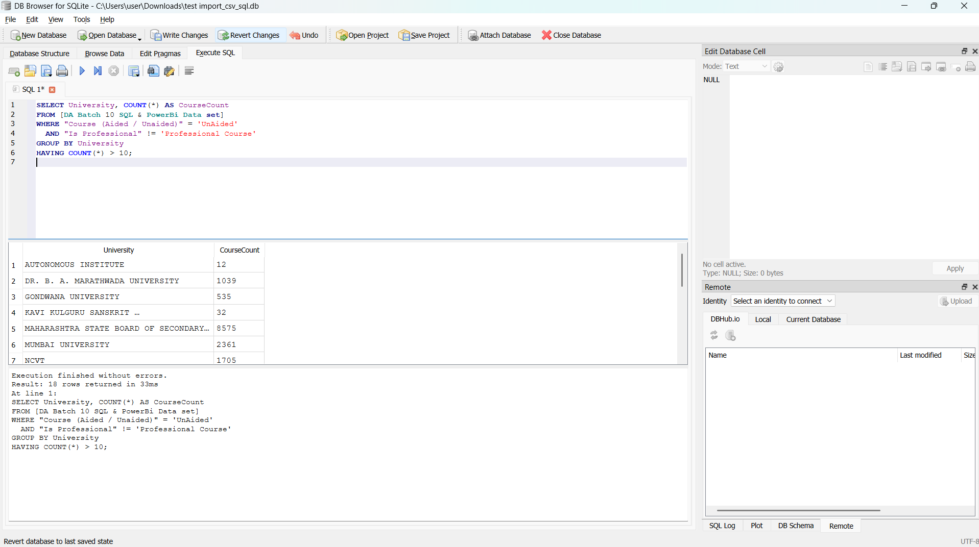
Q5 .List all universities that have more than 10 unaided courses that are not professional.

Slide 8
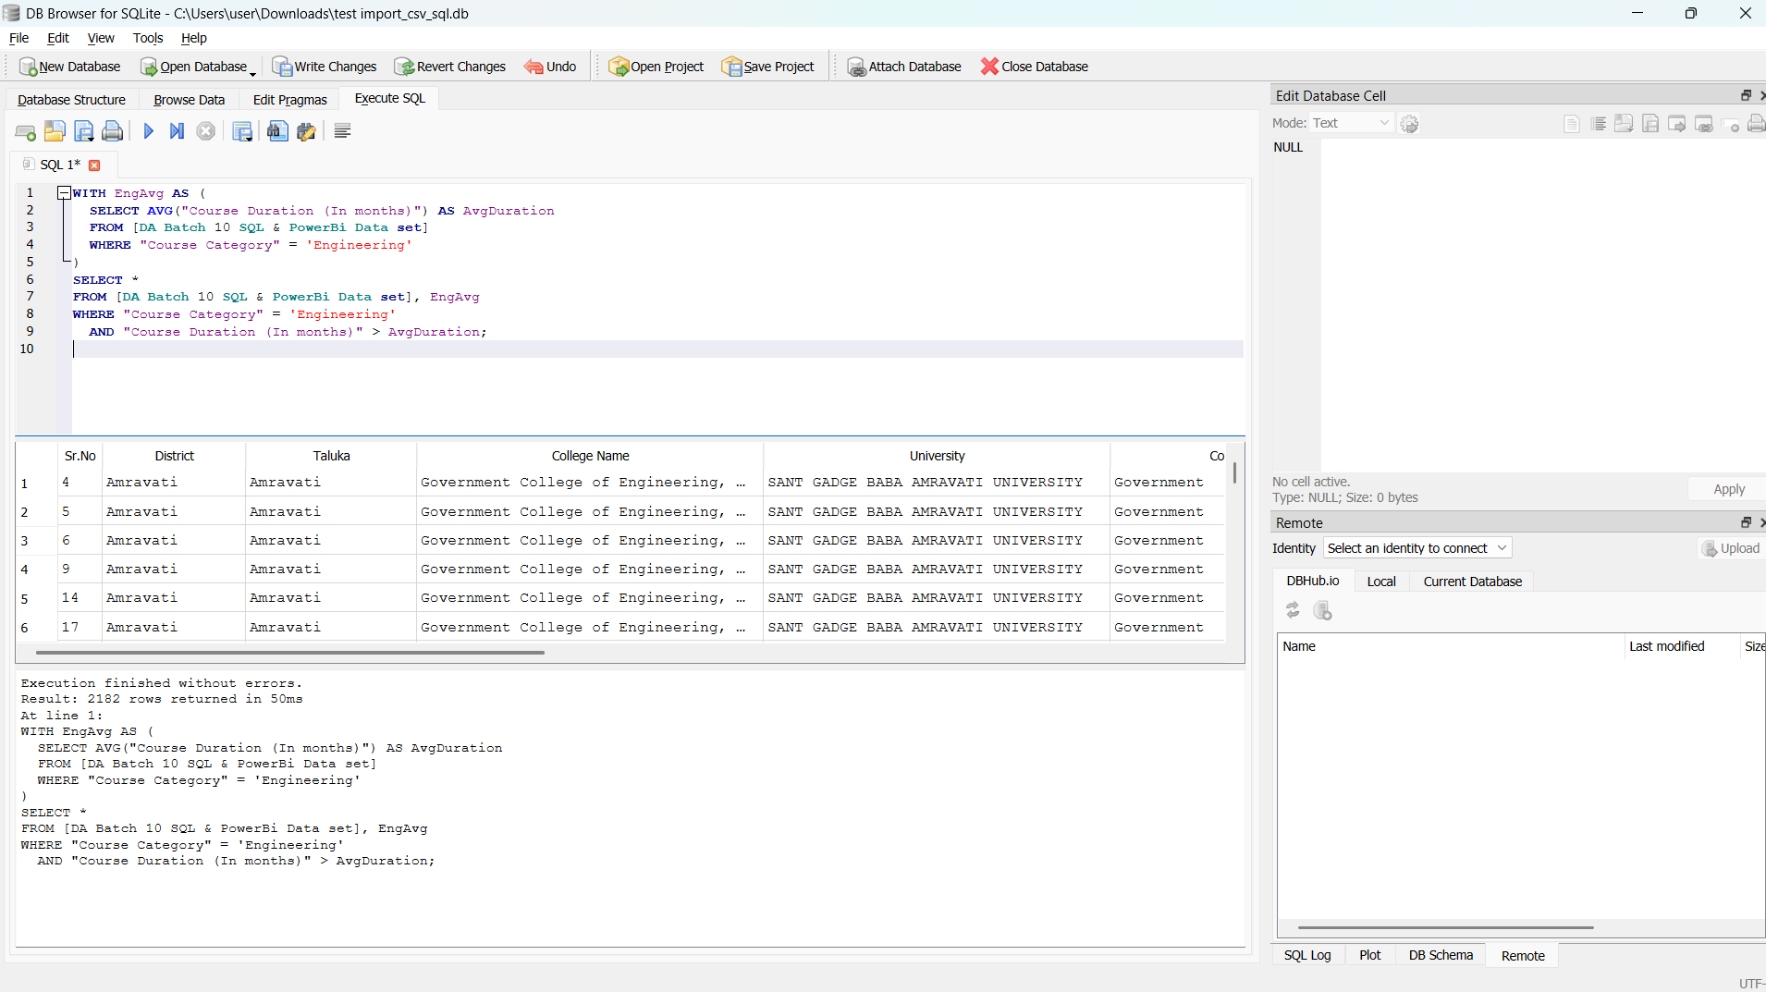
Q6. Display colleges from the "Engineering" category that have at least one course with a duration greater than the category's average.

Slide 9
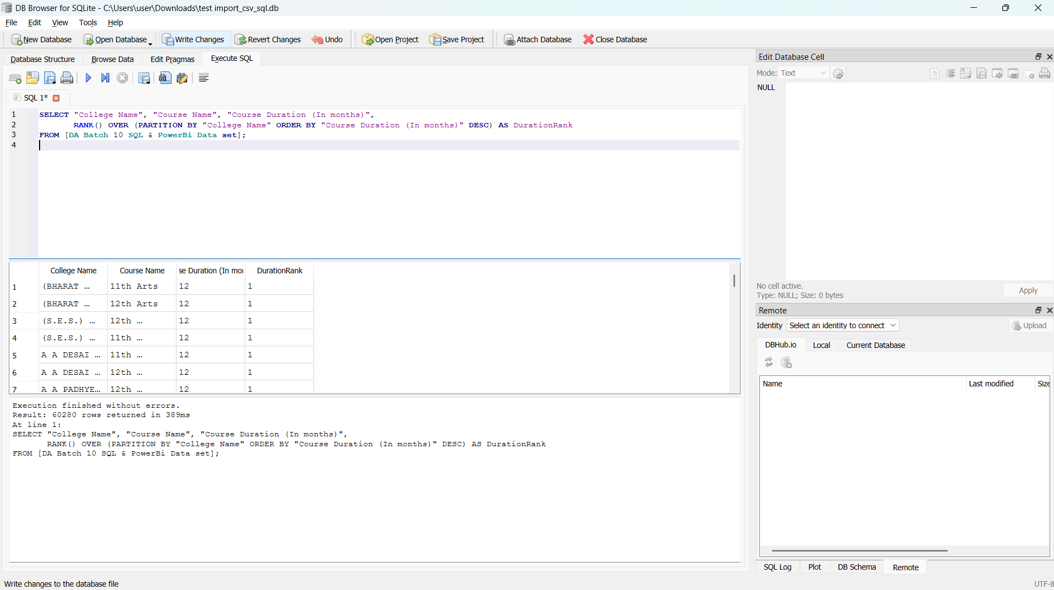
Q7. Assign a rank to each course within a College Name based on course duration, longest first.

Slide 10
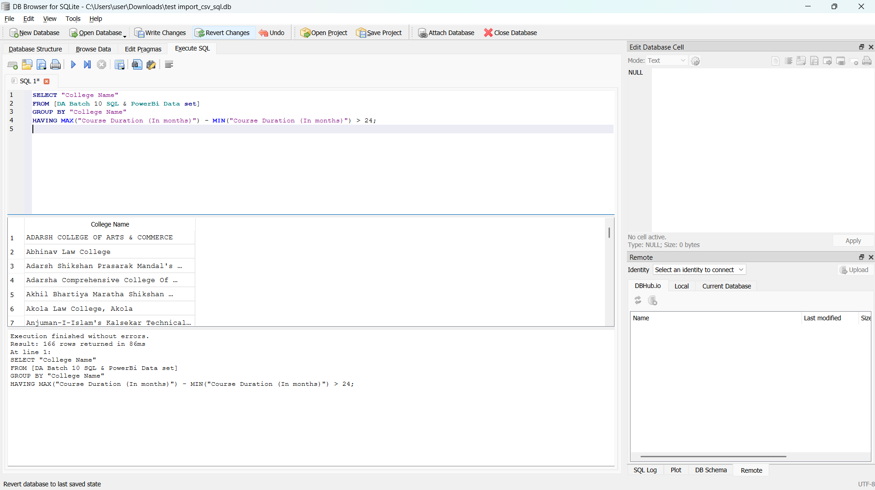
Q8. Find colleges where the longest and shortest course durations are more than 24 months apart.

Slide 11
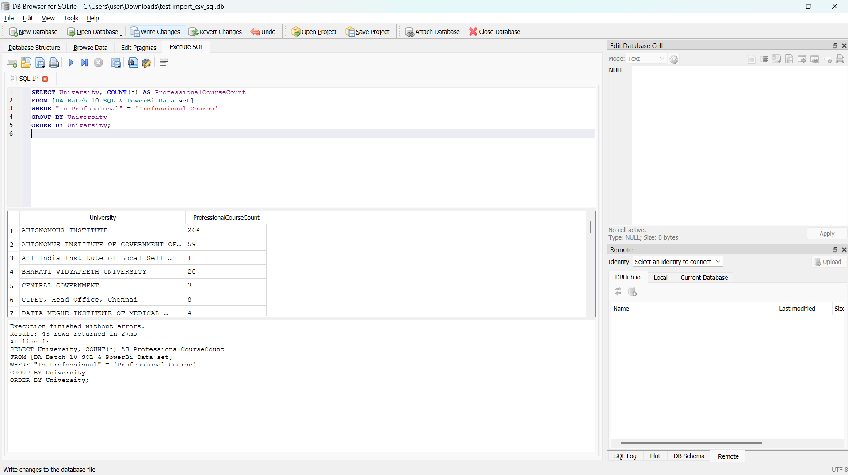
Q9. Show the cumulative number of professional courses offered by each university sorted alphabetically.

Slide 12
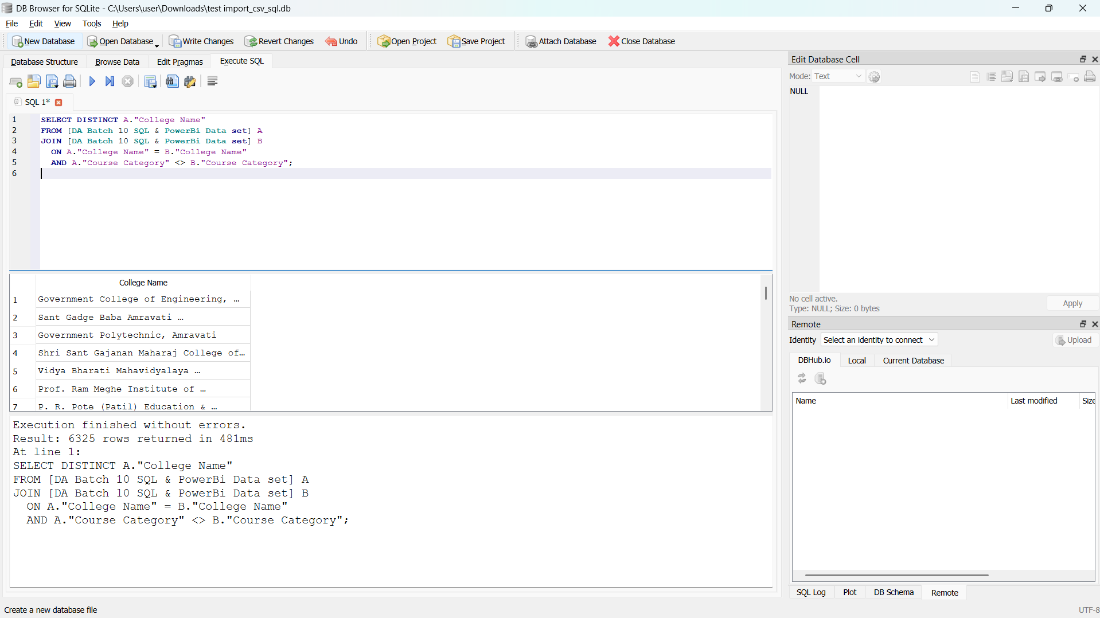
Q10. Using a self-join or CTE, find colleges offering more than one course category.

Slide 13
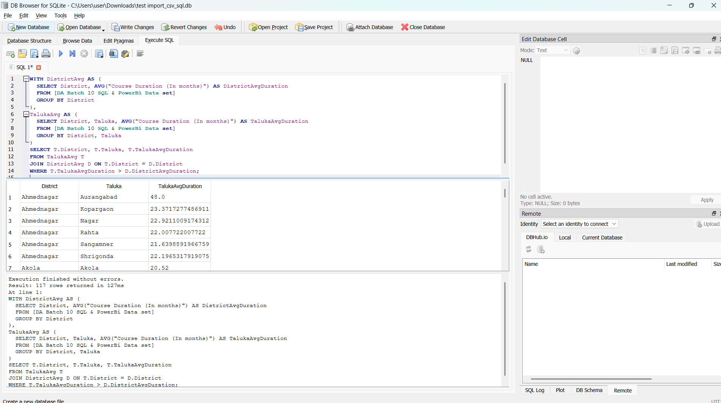
Q11. Create a temporary table (CTE) that includes average duration of courses by district and use it to list talukas where the average course duration is above the district average.

Slide 14
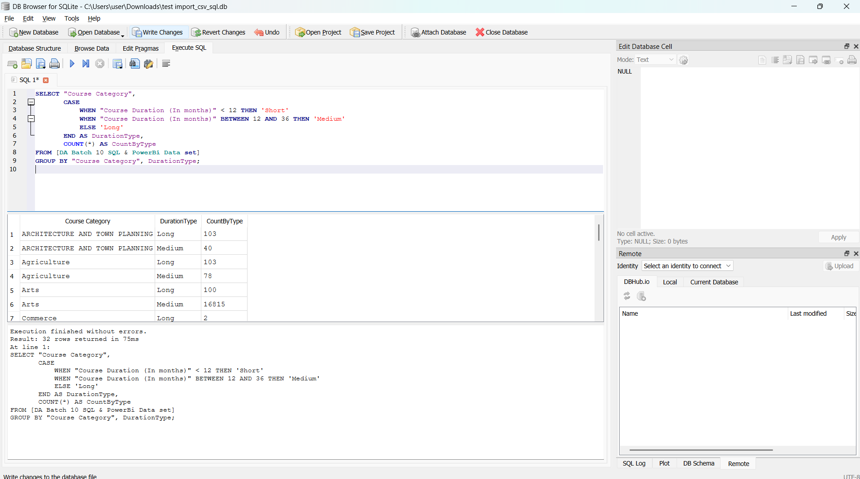
Q12. Create a new column classifying course duration as:
Short (< 12 months)
Medium (12-36 months)
Long (> 36 months)

Slide 15
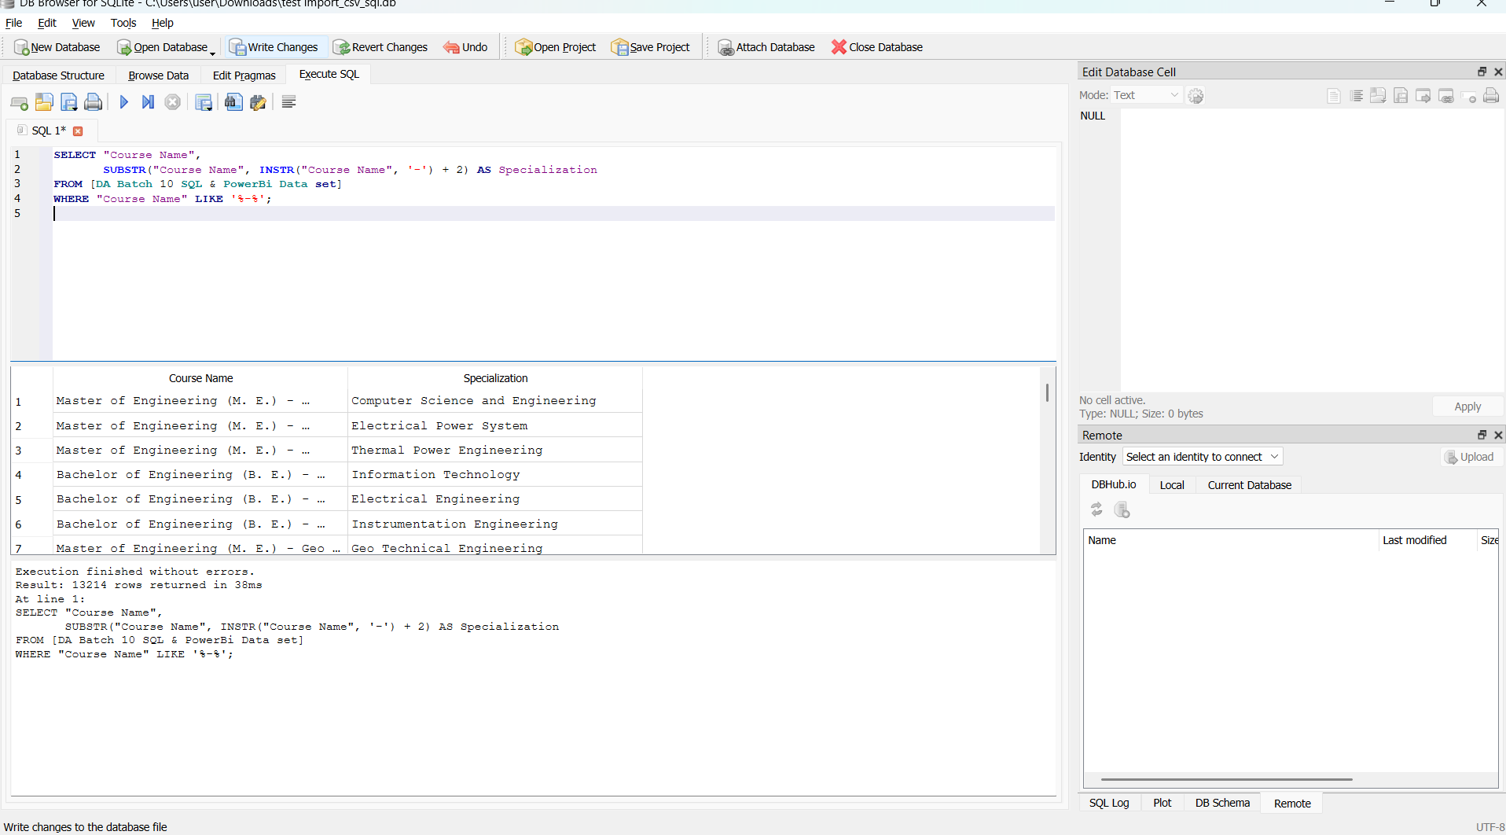
Q13 .Extract only the course specialization from Course Name. (e.g., from "Bachelor of Engineering (B. E.) - Electrical", extract "Electrical")

Slide 16
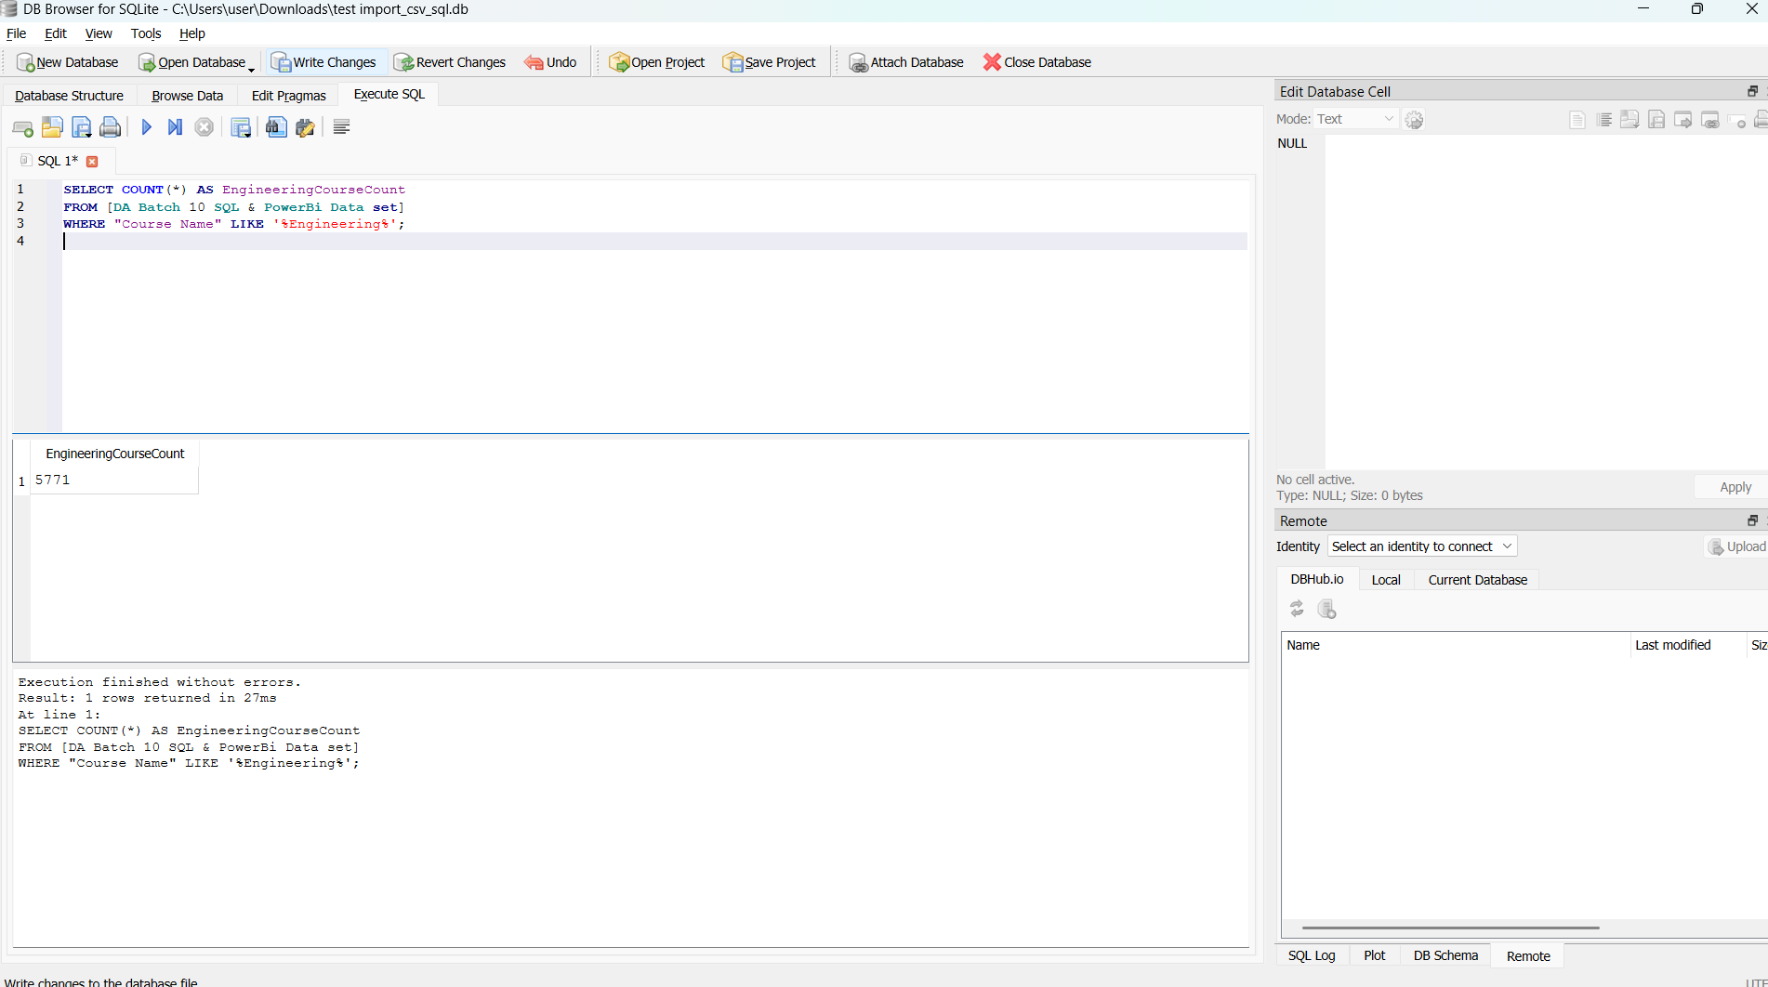
Q14. Count how many courses include the word Engineering in the name.

Slide 17
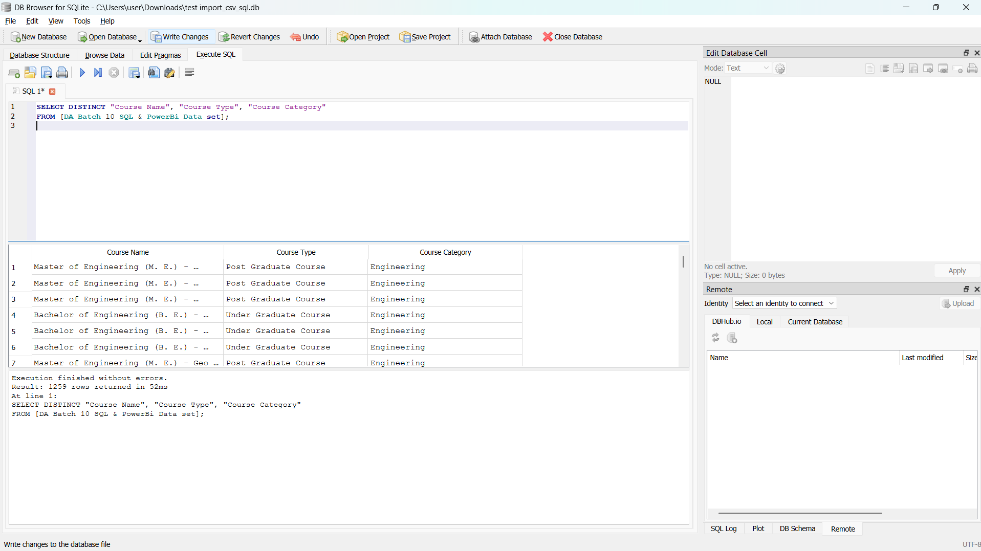
Q15 .List all unique combinations of Course Name, Course Type, and Course Category.

Slide 18
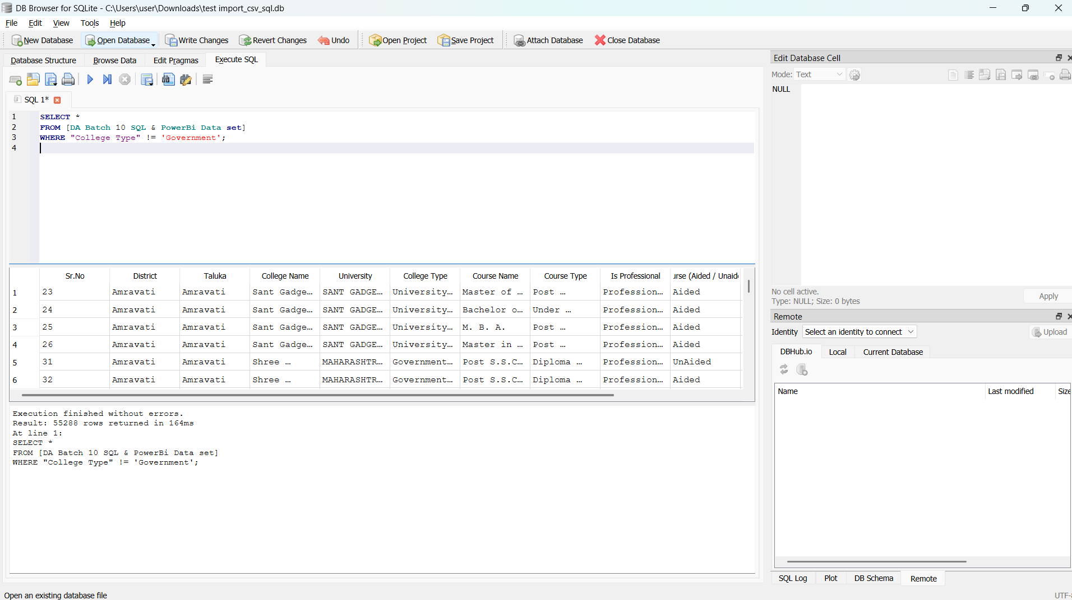
Q16 .Write a query to get all courses that are not offered by any Government college.

Slide 19
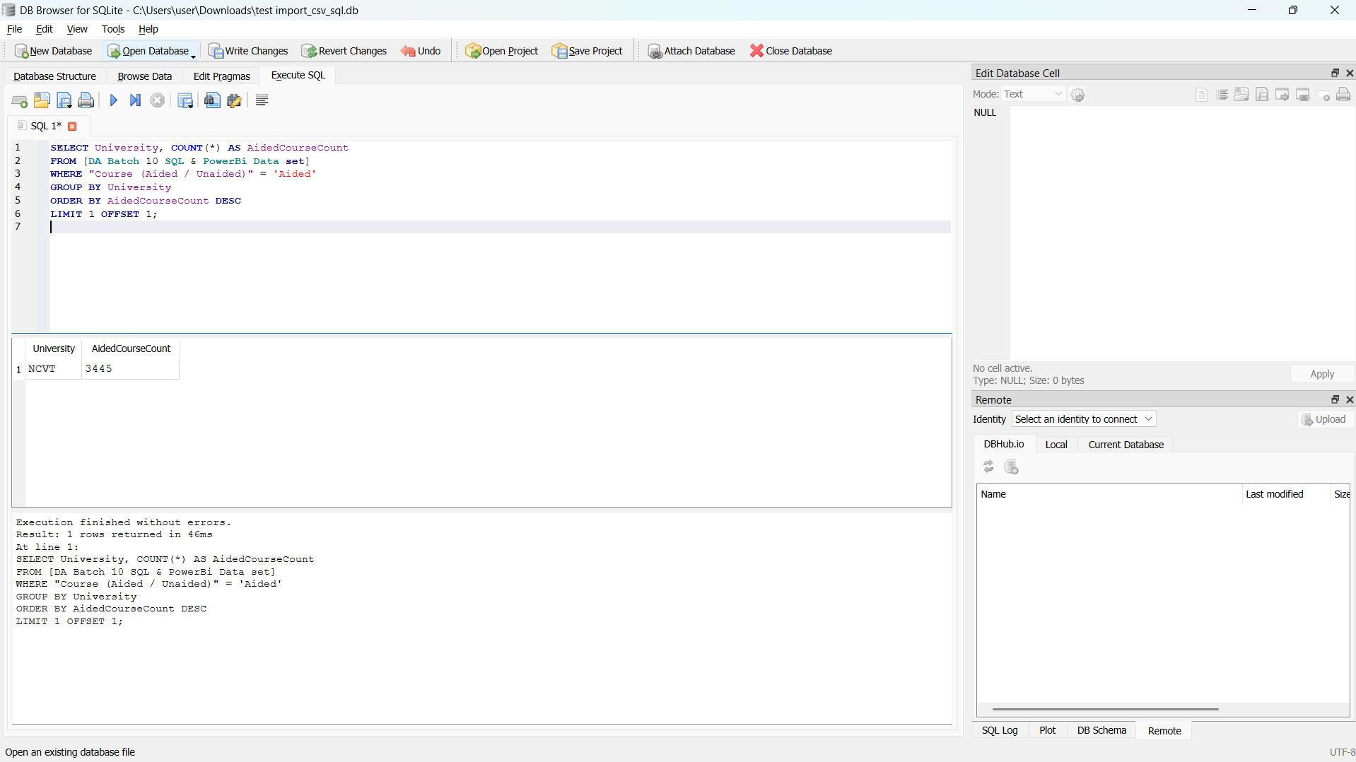
Q17 .Find the university that has the second-highest number of aided courses.

Slide 20
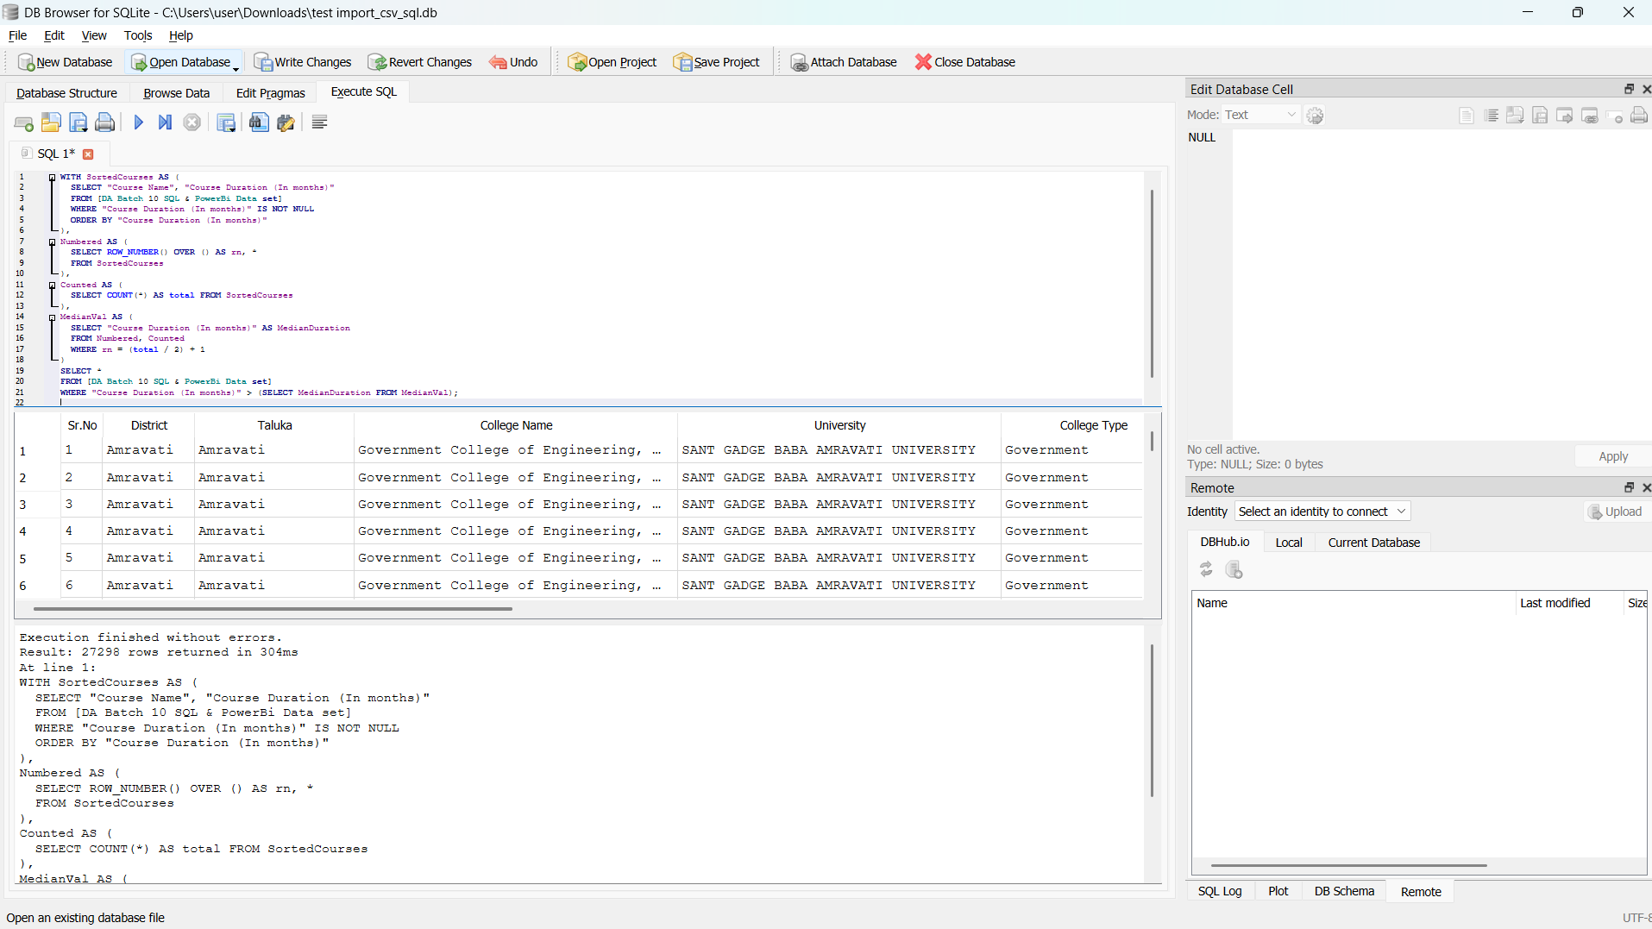
Q18 . Show courses whose durations are above the median course duration.

Slide 21
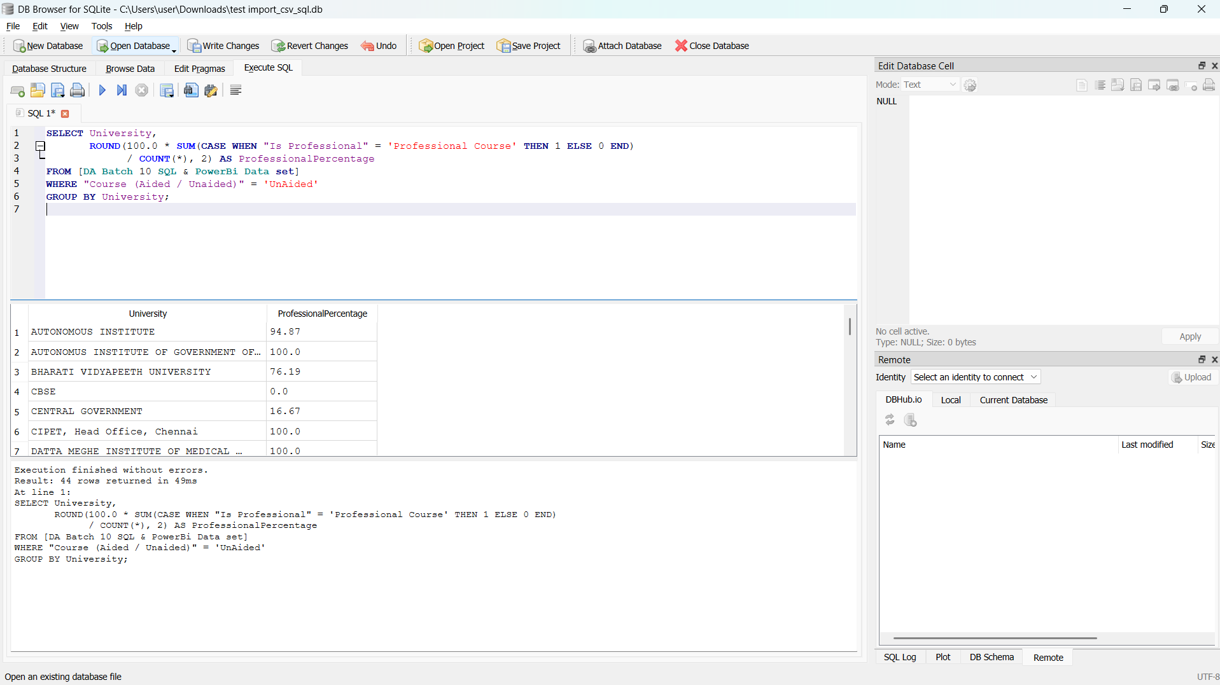
Q19 .For each University, find the percentage of unaided courses that are professional.

Slide 22
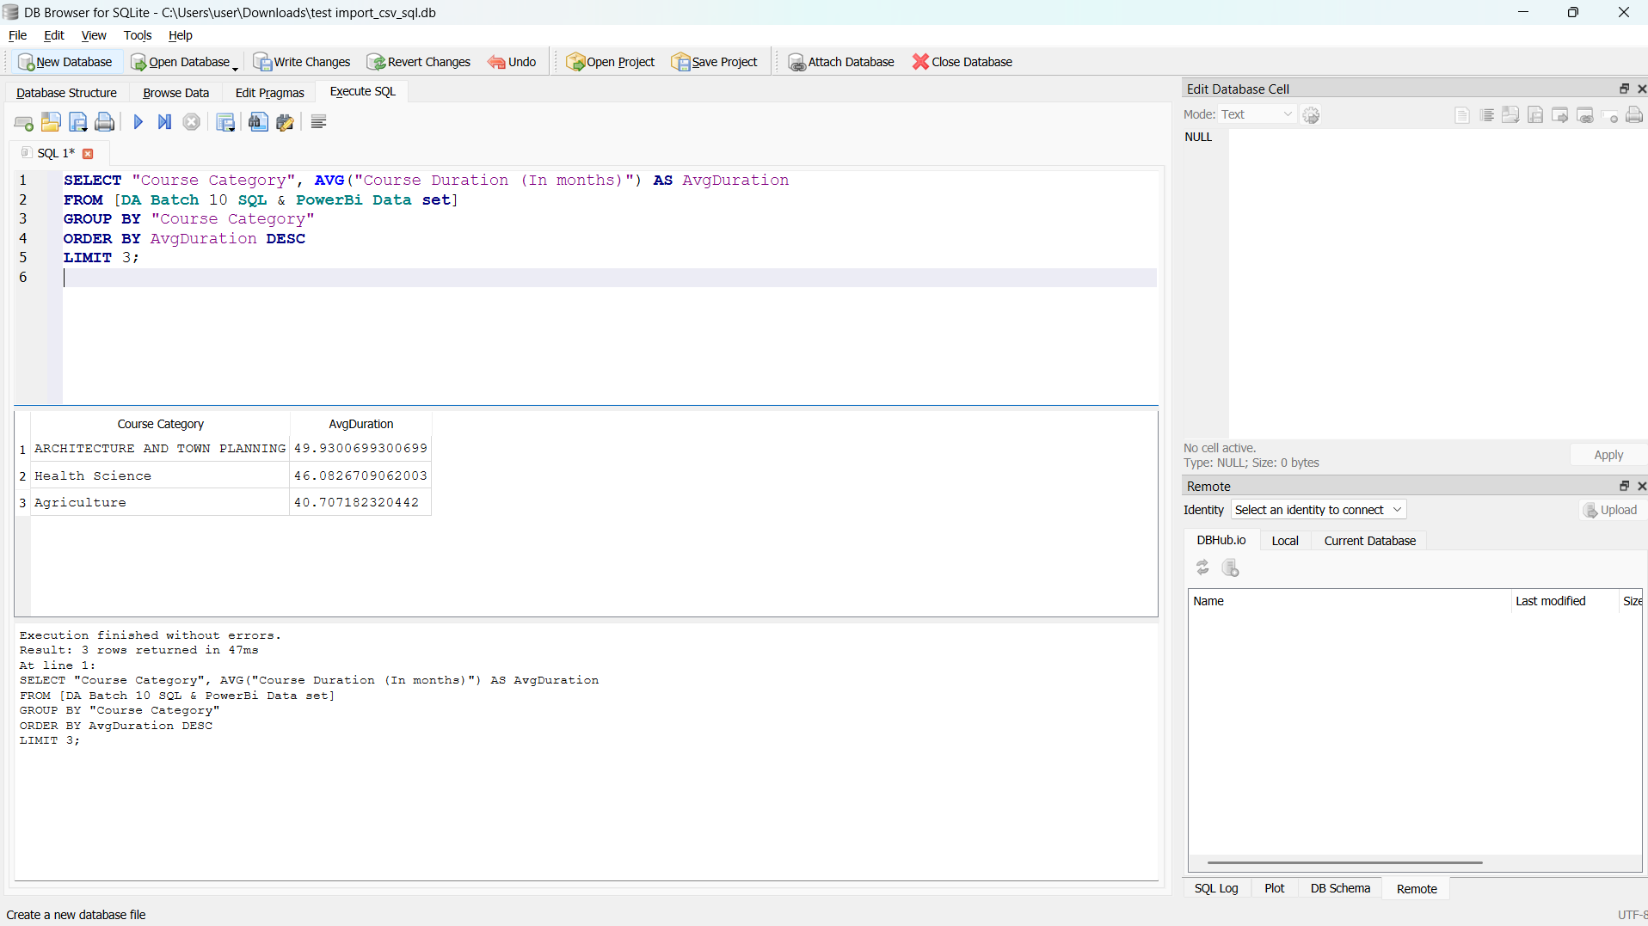
Q20 .Determine which Course Category has the highest average course duration and display the top 3.

Slide 23
Conclusion
Through this SQL-based analysis of higher education course data, I was able to uncover valuable insights related to course offerings, college distributions, and university-level trends. Despite initial technical limitations—such as auto-generated column names—I successfully mapped and interpreted the dataset to answer a wide range of analytical questions.
This project enhanced my ability to:
  Work with real-world data in SQL.
  Write complex queries using grouping, joins, CTEs, and filtering.
  Translate raw data into meaningful, actionable insights.
Overall, this task strengthened my skills in data exploration and problem-solving, while giving me practical experience in using SQL as a tool for analysis and reporting.

Slide 24
Thank you

